Slide 1
Find intersection of a line and a plane
Line Equation
With three points, intersection occurs if

Slide 2
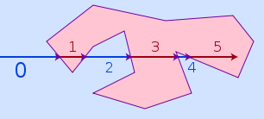
3D Meshing an STL File
Determine the bounding box in 3D space for the object (xmin, ymin, zmin) to (xmax, ymax, zmax)
Starting from a point outside the domain cast a ray starting at (X0, Y0, Z= (Zmin - 1) in the Z direction
Using the point in polygon technique: determine the number of intersection points of the polygon
Preallocate memory (# of intersection points) [0 z1 z2 z3 z4] the region between at (x0,y0) z1 and z2 is in the domain

Slide 3
Meshing Algorithm
Problem: Given an arbitrary geometry defined by a set of equations produce a finite element mesh in 3D/2D
Solution:
  Step 1: Define the Geometry by a list of equations which mathematically define the domain and formulate them such that given a point (x,y,z) we can determine if it exists in the domain (false or true)
  Step 2: Bound the geometry by its maximum and minimum dimensions in X-Y-Z directions
  Step 3: Create a 3D point cloud that is linearly spaced in each direction (dX = h1, dY = h2, dZ = h3) and only contains points that fall within the domain. These 3D points are the corner nodes of the mesh
  Step 4: Connect nodes together that can form a cuboid element of size (h1,h2,h3) and whose midpoint falls within the domain. If it fails this initial criteria, try to form a triangular prism with connected nodes whose midpoint falls within the domain. If that fails, try to form a tetrahedron. If that fails, move on the the next node.

Slide 4
Meshing Algorithm
Step 5: Insert edge nodes (depending on which interpolation order you want to use)
Step 6: Refinement procedure:
    Make a list of elements chosen for refinement
    Remove edge nodes from those elements
      If the element is cuboid split it into 8 equal quadrants
      If the element is a triangular prism split the triangle into three triangles and the extrusion into two leaving 6 triangular prisms
      If the element is a tetrahedron, insert a point into the midpoint of the element creating 4 tetrahedrons
    Add add nodes to the new elements

Slide 5
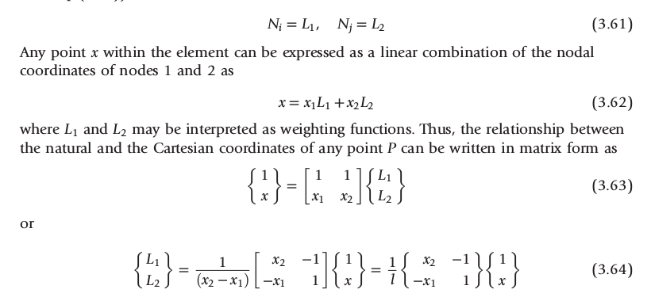
Shape Functions
1D Line Element

Slide 6
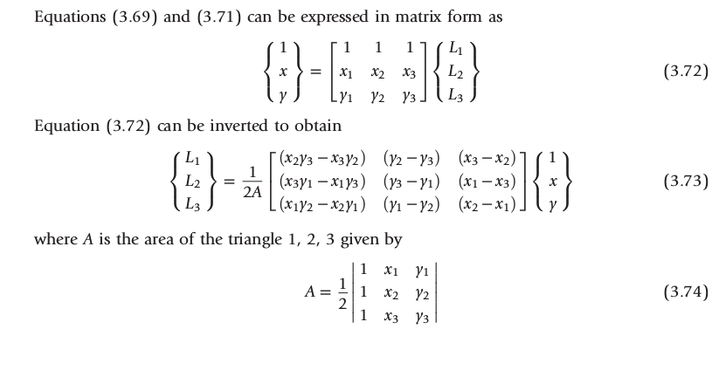
Shape Functions
2D Triangular Element

Slide 7
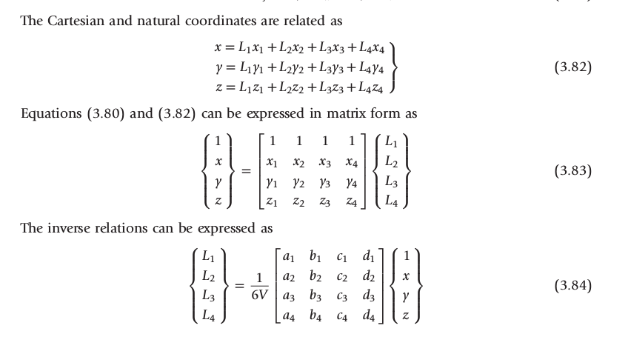
Shape Functions
3D Tetrahedral Element

Slide 8
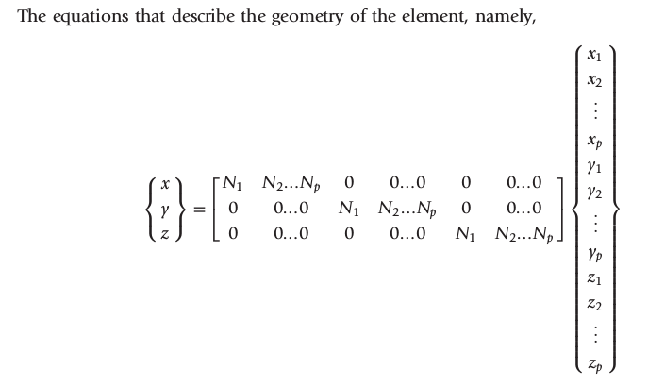
Generalized Shape Function Relation

Slide 9
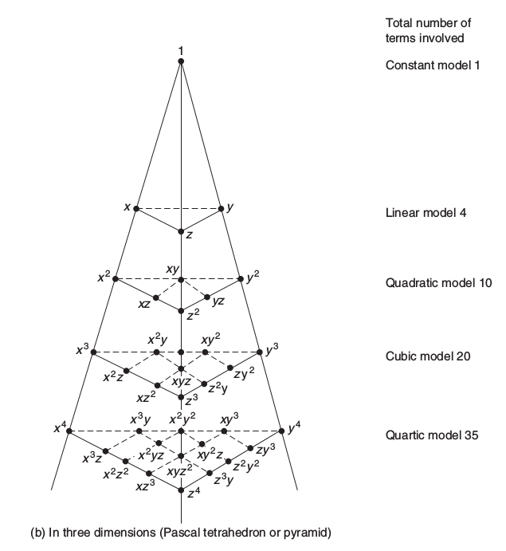
Relation of natural coordinates to Shape Functions

Slide 10
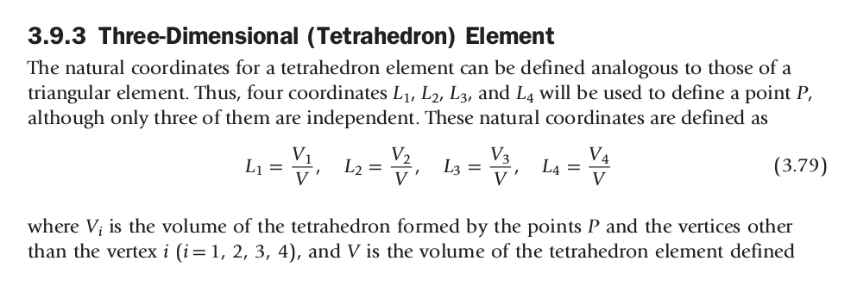
Relation of Natural Coordinates to Shape Functions

Slide 11
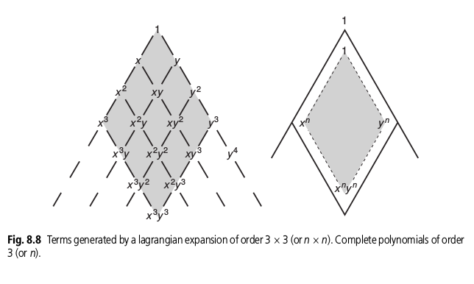
Relation: For 3d element create a lagrangian expansion of (n x n x n)

Slide 12
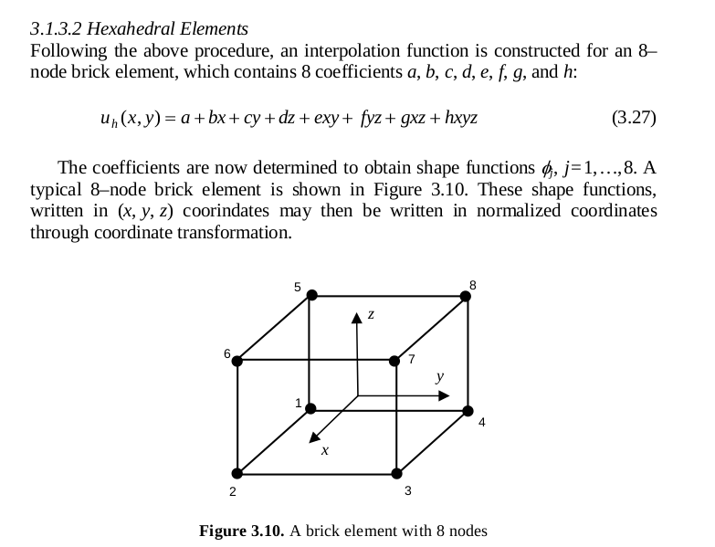
3D Brick Element

Slide 13
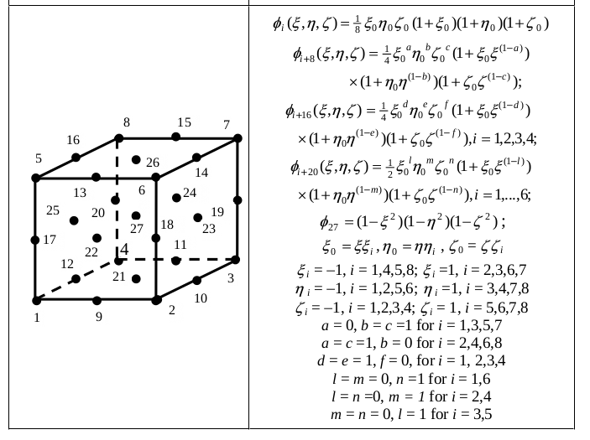
27 Node Element:

Slide 14
CBS Flow Algorithm

